Slide 1
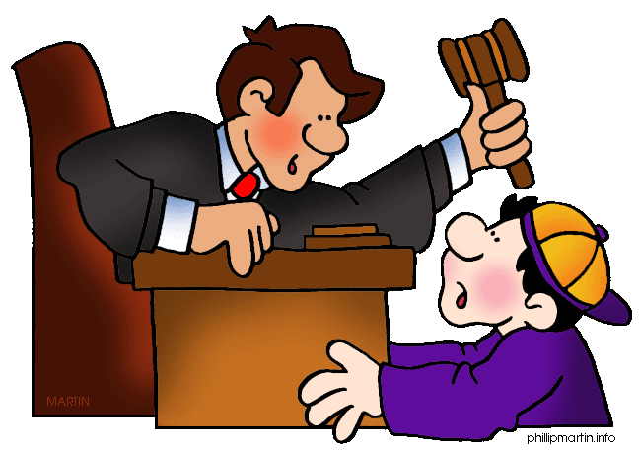
CONFLICT
The struggle between opposing forces

Slide 2
What is Conflict?
Good
Evil
The struggle between opposing forces.
Peter Pan
Captain Hook
Notes:
Have students commit the definition to memory. Students may have been introduced to this concept in earlier grades as the problem, however, conflict is a more comprehensive term. Explain that conflict isn’t always between two characters, or even between good and bad; and it doesn’t necessarily involve a fight. A character may be dealing with personal difficulties or battling forces of nature. Have students identify the struggles of famous characters like Nemo, Shrek, E.T., Harry Potter, Spiderman, etc.

Slide 3
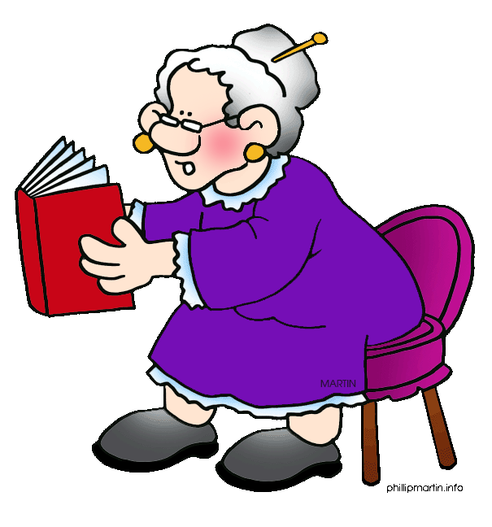
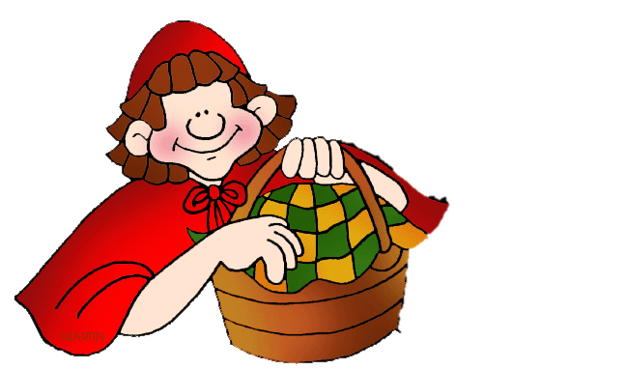
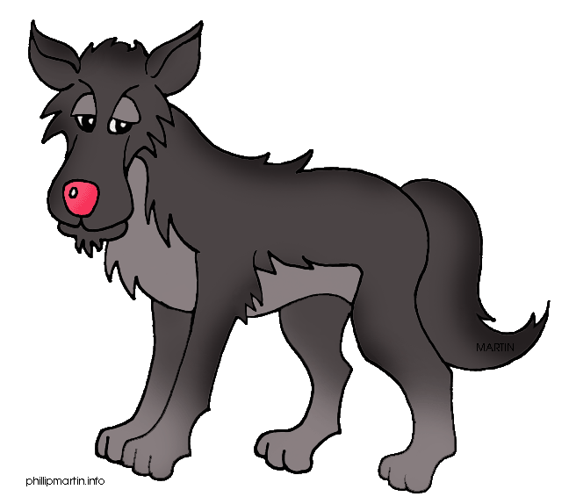
Why conflict?
At the heart of every great story is a conflict (or problem). The main character wants something and is being prevented from getting it.
Little Red Riding Hood wants to go visit her Grandmother…
…but the Big Bad Wolf interferes.
Notes:
It doesn’t matter whether it is a movie, a television episode or a book—the thing that creates interest is that the main character wants something and is struggling to get it.

Slide 4
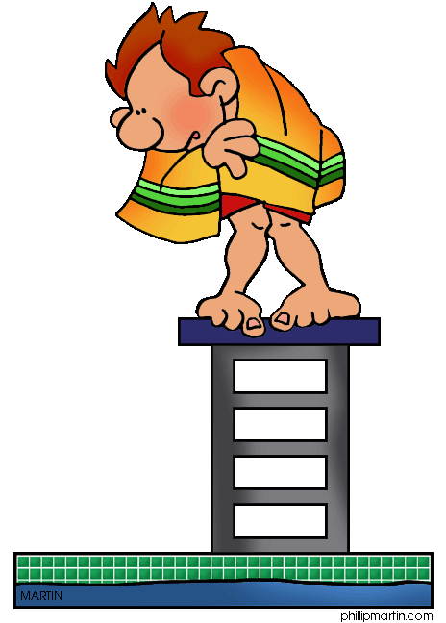
Conflict Makes the Story Interesting!
Most of the action and suspense in a story centers around the main character (or characters) trying to find a solution to the conflict.
Conflict drives the plot !
Notes:
To explain this principle, use examples from current movies or books with which the students are familiar. For example, Dorothy is just an ordinary girl with a yapping dog until she ends up in Oz with a wicked witch chasing her. The whole story is about her trying to end her problem. Have students come up with several similar examples. Instruct students that when the conflict ends the story is over. Dorothy gets home (she gets what she wants) and the movie ends. This part of the plot is called the resolution, but more about that later.

Slide 5
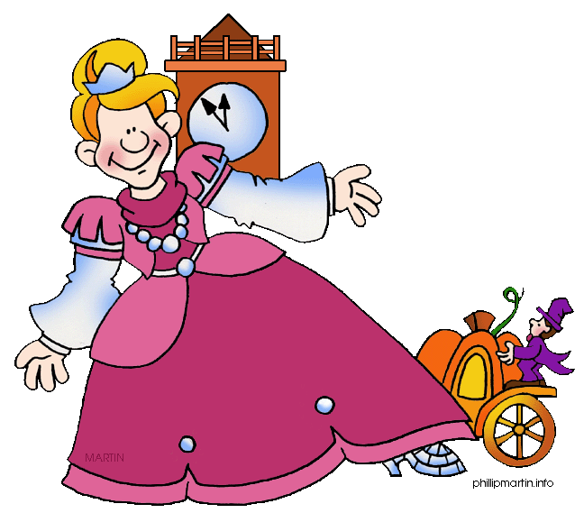
Identify the conflict
The most effective way to identify a conflict is to write a CONFLICT STATEMENT.
A conflict statement is a sentence that briefly states what the main character wants and what is preventing him/her from attaining that desire.
Example: Cinderella wants to go to the ball, but her wicked stepmother won’t let her go.
Notes:
Explain that a conflict statement is a simple, but effective way to identify the conflict of the story. Point out in the example sentence the protagonist, what Cinderella wants, and what is preventing her from attaining her desire. Before learning the process of writing a conflict statement, it is important to review the literary terms protagonist and antagonist.

Slide 6
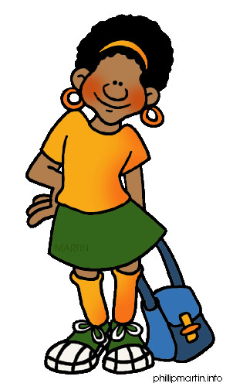
protagonist
The main character(s) who has the conflict
Notes:
Before learning the process of writing a conflict statement, it is important to review the literary terms protagonist and antagonist. The protagonist is the main character or characters who are experiencing the problem. Have students list the protagonists from various movies and stories. Point out that a protagonist is not always a human character.

Slide 7
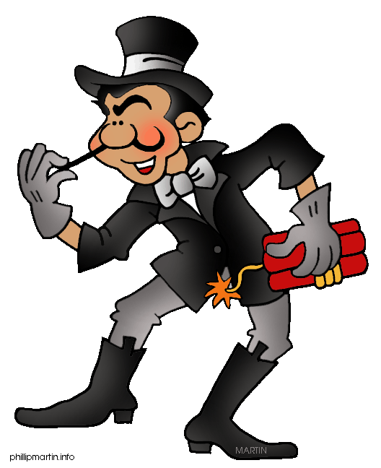
Antagonist
Who or what the protagonist is struggling against
Not always a bad guy. In fact, sometimes it is not even a person!
Notes:
An antagonist is any force against which the protagonist struggles. It can be another character, natural elements, emotions or even a belief system or way of thinking. It is important to emphasize that the antagonist is not always a person. Give several examples from texts or movies with which students would be familiar. For example, in the Jack London story “To Build a Fire” the protagonist is struggling against the cold and against time. In the novel (movie) The Hunger Games, Katniss is struggling against the hunger and poverty that her community faces. Have students identify the antagonist in other movies and stories. Remind them that just as there can be multiple protagonists, there may also be multiple antagonists. One way to help students remember the meaning of the term antagonist is to point out the root “anti” which means against.

Slide 8
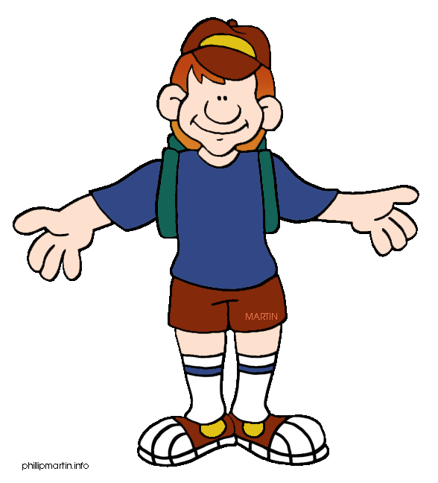
Writing a conflict statement
PROTAGONIST
WANTS ______,
BUT…
Notes:
Learning to write a conflict statement takes a little bit of practice, but it is worth it because most conflicts can be identified using this technique. First, identify the main character or protagonist of the story. For example, Cinderella. Second, write the word “wanted” followed by the main thing the character is hoping to have or achieve. For example, Cinderella wants to go to the ball. Finally, write the word “but” followed by the antagonistic element that is preventing the protagonist from getting what he or she wants. Example, “but her stepmother locks her in her room,” or “she doesn’t have a dress to wear.” Note that a conflict statement can be written in the negative: The finicky eater doesn’t want to eat green eggs and ham, but Sam-I-Am keeps bugging him.

Slide 9
Conflict Statement Practice
Protagonist:
What protagonist wants:
What is keeping the protagonist from getting what she wants:
Conflict Statement:
Notes:
Again select a story with which the class is familiar and fill in the information as students provide it. Type student responses directly into the interactive text boxes. Consider using movies like Dorothy and the Wizard of Oz, Cars, Finding Nemo, Titanic, or Twilight. Have students practice the process several time. (If you are using the “Conflict Journal Entry” sheets a place is provided for students practice writing conflict statements with Finding Nemo and Jack in the Beanstalk.

Slide 10
On Your Own…
Conflict Practice 1
With his big ears, Horton the Elephant can hear the tiny Who’s calling for help, but nobody believes him. The elephant tries to protect the Who village, but the speck of dust they live on is stolen by a group of mean monkeys and dropped into a gigantic clover field.
Notes:
Have students write a conflict statement for this summary in their journals. (If you are using the “Conflict Journal Entry” sheets, a place on the handout is provided to complete this activity and the one on the following slide.) An appropriate conflict statement for this summary is: Horton wants to help the Who’s, but their village is taken by monkeys.

Slide 11
On Your Own…
Conflict Practice 2
When Ruth was 5-years-old she became very ill with scarlet fever and lost all of her teeth. When school started in the fall, she begged her mother not to make her go because she was embarrassed. She knew that the other kids would make fun of her and she would never be able to talk and make friends. Her mother, however, insisted that she go and continued to buy school supplies. When the big day arrived, Ruth hid in her closet under a pile of clothes, but her mother quickly discovered her hiding place and pulled her kicking and screaming out of the closet and out to the bus stop.
Notes:
Have students write a conflict statement for this summary in their journals. (If you are using the “Conflict Journal Entry” sheets, a place on the handout is provided to complete this activity.) An appropriate conflict statement for this summary is: Ruth doesn’t want to go to school, but her mother makes her.

Slide 12
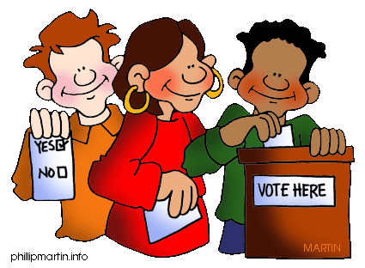
Basic Types of Conflicts
Notes:
Although there are many types of conflicts, these four are a good place to begin. Usually in simple stories like fairy and folktales, picture books, and TV sitcoms, only one type of conflict is developed. However, in more complex works like movies and novels several different types of conflict carry the plot. For example, the movie Titanic features a character vs. nature (the ship against the iceberg, and the passengers against the freezing water), character vs. society (prejudice Jack faces in trying to connect with Rose’s high society); character vs. self (Rose’s dilemma of whether or not to be with Jack in spite of her family’s disapproval), and character vs. character (Rose vs. her father; Jack vs. Rose’s family)

Slide 13
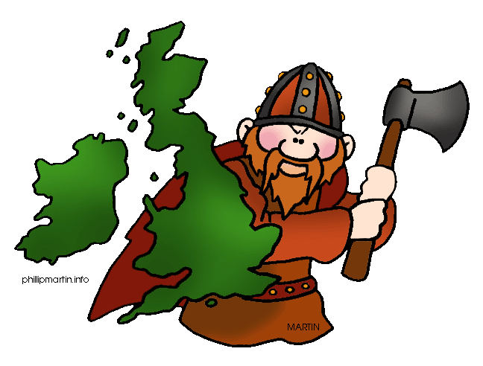
1) Character vs. Character
Other characters or groups of characters; sometimes it is a villain, but not always
Notes:
Examples: Batman vs. The Joker; Harry Potter vs. Voldemort; Little Red Riding Hood vs. The Big Bad Wolf.
Have students give examples of character vs. character conflicts

Slide 14
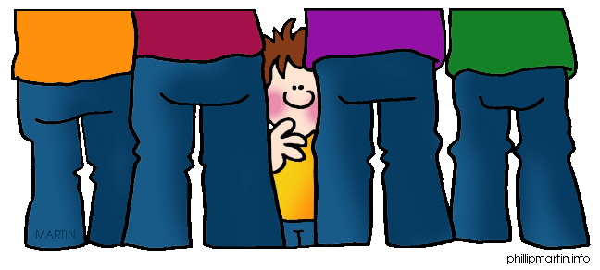
2) Character vs. Society
Rules or laws, cultural norms, a society’s system of beliefs, standing up for what is believed
Notes:
Example: The Other Side—the girls are separated by segregation but want to play together; Among the Hidden—Law says only two children, this family has three and are trying to hide; Habibi —Palestinian girl is in love with a Jewish boy; Number the Stars —Characters are trying to rescue Jewish neighbors.
Have students share examples of movies or books with a character vs. society conflict.

Slide 15
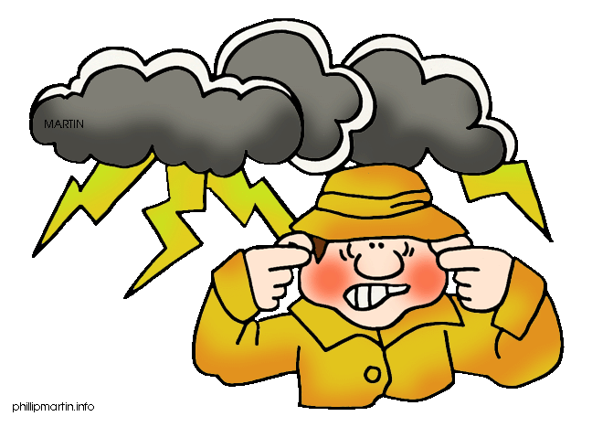
3) Character vs. Nature
The weather, cold, disease, wild animals, hunger, fire, natural disasters
Notes:
Example: Hatchet Brian vs. the coming winter and hunger; Fever 1692: Girl’s family becomes sick with yellow fever and she has to care for them
Have students share examples of stories with the character vs. nature conflict.

Slide 16
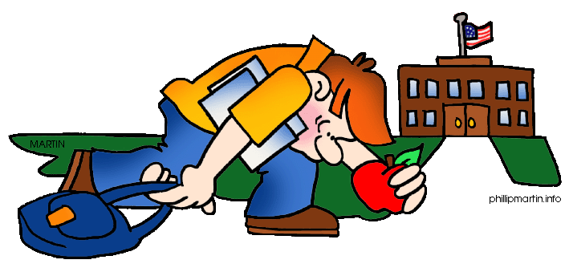
4) Character vs. Self
Loneliness, self-doubt, making a tough decision, poor self-esteem, overcoming addiction, jealously
Notes:
Example: Swallowing stones—Boy has to decide whether to tell the truth; Waiting for Normal—Girl is overweight and has to overcome her eating habits; Waiting for Normal—Girl is overweight and has to overcome her eating habits; Slam!—Boy wants to play ball, but he has to bring his grades up

Slide 17
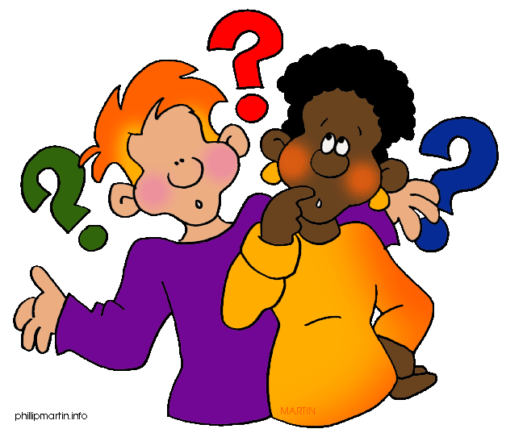
Concept Review
What is the definition of conflict?
Why do stories have conflicts?
How do you create a conflict statement?
What are the four basic types of conflicts?

Slide 18
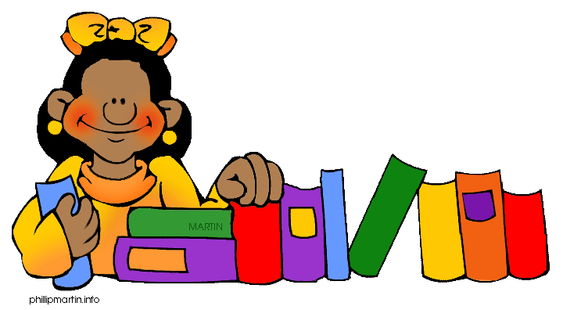
On Your Own…
Identify the type of conflict represented by each of the following book summaries.
Write a conflict statement for each summary

Slide 19
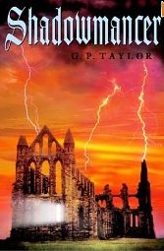
Shadowmancer
Obadiah Demurral isn’t satisfied running the affairs of his village. Now he wants to control the world, as well as God and His angels—and he will stop at nothing. Who will stand against him? Raphah has come a long distance to reclaim the ancient relic Demurral has stolen, but Raphah is young. And so are Thomas and Kate, who are drawn into this war between good and evil. Their struggle against Demurral will bring them face-to-face with the powers of darkness in an epic battle.
Character vs. Character
Raphah wants to reclaim the ancient relic, but Demurral is trying to control the world.

Slide 20
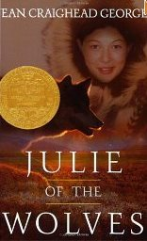
Julie of the Wolves
At 13, an orphan and unhappily married, Miyax runs away from her husband's parents' home, hoping to reach San Francisco and her pen pal. But she becomes lost in the vast Alaskan tundra, with no food, no shelter, and no idea which is the way to safety. Without food and time running out, Miyax tries to survive by copying the ways of a pack of wolves.
Character vs. Nature
Julie wants to reach San Francisco, but she is lost in the Alaskan wilderness.

Slide 21
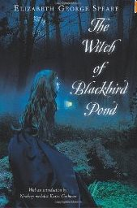
The Witch of Blackbird Pond
Orphaned Kit Tyler is forced to move in with her stern Puritan relatives and she feels like a tropical bird that is now caged and lonely. The only place where Kit feels completely free is in the meadows, where she enjoys the company of the old Quaker woman known as the Witch of Blackbird Pond. But when Kit's friendship with the "witch" is discovered, Kit is faced with suspicion, fear, and anger. She herself is accused of witchcraft!
Character vs. Society
Kit wants to be free to be friends with an older woman, but she is accused of being a witch.

Slide 22
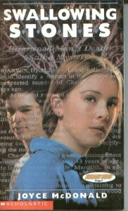
Swallowing Stones
The best day of Michael Mackenzie's life becomes the worst when the bullet he fires into the air during his 17th birthday party comes down a mile away and kills a man. When he hears the story on the radio, the news hits him like a lightning bolt. Numbly following the advice of his best friend, Joe, he buries the rifle and tries, without much success, to get on with life. Tortured by remorse, Michael must find a way to ease his guilt and pain.
Character vs. Self
Michael doesn’t want anyone to find out he has killed a man, but he is tortured by guilt.

Slide 23
Credits
Created by
Barbara Yardley, M.Ed.
barbarayardley@me.com
ClipArt by
Phillip Martin
http://www.phillipmartin.info/clipart/homepage.htm

Slide 24
Links/Resources
The Librarian’s Daughter
Ms. Yardley’s blog about books to use in the classroom with particular
emphasis on adolescent literacy
Persuasion in a Digital World
ReadWriteThink lesson plan for teaching persuasive writing using digital tools.
Authored by Ms. Yardley and Ms. Perdomo
Teachers Pay Teachers: Yardley
Reading activities and units written by Ms. Yardley, including worksheets and
activities about conflict

